Slide 1
User Experience Insights API Proposal

Slide 2


Use Cases
Reason :
In the current mobile ecosystem, application developers often treat the underlying telecommunications network as a "black box." While apps can monitor signal bars or local latency on the device, they lack access to the carrier-grade network intelligence residing in the 5G Core.
The User Experience Insights API is designed to expose this internal network "vision." By leveraging real-time data from network elements, it provides developers with high-fidelity Quality of Experience (QoE) scores and predictive network trends. This shifts the paradigm from reactive error-handling on the device to proactive business adaptation based on network-side intelligence.
Scenario 1: Closed-loop Adaptation for Hyper-sensory Services
Scenario 2: Quality-Guaranteed Premium Ad-Insertion (OTT)
Perceptual Feedback: Cloud gaming or XR platforms establish a high-frequency feedback loop based on the API
Fine-grained Adjustment: Based on the score and bandwidth headroom returned by the UXI, the application layer fine-tunes the rendering engine's output parameters (such as frame rate and resolution) in real time.
Smart Asset Selection: The OTT Ad-Server uses the API to assess the Real-time Experience Score just before the ad-break.
Dynamic Delivery: High-value 4K ads are only served when UXI confirms a high-quality connection; otherwise, a lighter version is used to ensure uninterrupted playback.
Notes:
制造业替换成公共事业
智慧农业 - 智慧零售
物联网卡设备 确保物联网设备的 被合理使用 机卡绑定 区域限制 并在一起

Slide 3
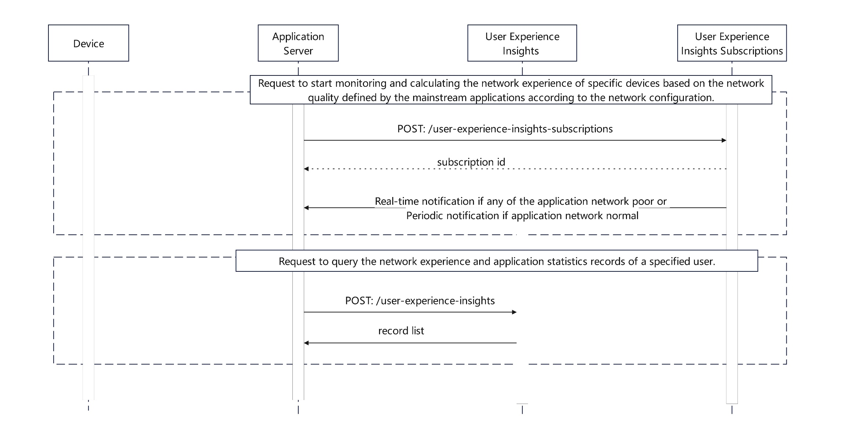
The API definition proposal(flow chart)
Notes:
只提供查询能力

Slide 4
The API definition proposal(subscribe)
API Name | User Experience Insights Subscriptions API
Description | This interface is used to subscribe to the latest detailed usage statistics of the application and the network experience score data in roaming areas.
Input Parameters | device(Device)：The developer can choose to provide the below specified device identifiers: ipv4Address, ipv6Address, phoneNumber,networkAccessIdentifier.
 | appcationType(emum)： Indicates the Application type. Negotiated by the carrier and application vendor and configured on the carrier network. Enum：video/game/Live-Video. Note: Configure mainstream applications on the carrier's network.
 | subscriptionExpireTime(string)：The subscription expiration time (in date-time format) requested.
 | datatype(emum) ：Data reporting type. The system can report poor network quality in real time or periodically.
 | sink(string)：The address to which events shall be delivered using the selected protocol.
 | sinkCredential(SinkCredential)：A sink credential provides authentication or authorization information necessary to enable delivery of events to a target.
Return Results | result (object): Subscriptions operation status, success or fail
Notes:
只提供查询能力

Slide 5
The API definition proposal(Report)
API Name | User Experience Insights Subscribe Notify Report
Description | The API is used to notify event information.
Report | areaData(Object)：General location information of the application. It include city and administrative district.
 | appSignalingData(Object)： Network signaling information. It include dnn/qciOr5qi and net access type.
 | applicationIndicatorStatistics(Object)：Basic statistical data within the application period. It includes uplink and downlink statistics, maximum uplink and downlink rates, total application access traffic, total uplink traffic, and total downlink traffic.
 | applicationExperienceAnalysis(Object)：Network experience analysis report. It includes information such as the application's bit rate, maximum bit rate, average bit rate, duration, latency, jitter, and ultimately provides a network quality score.
Notes:
只提供查询能力

Slide 6
The API definition proposal(query)
API Name | User Experience Insights Query API
Description | This API allows you to obtain the latest detailed usage statistics of applications as well as network experience rating data for roaming areas.
Input Parameters | device(Device)：The developer can choose to provide the below specified device identifiers: ipv4Address, ipv6Address, phoneNumber,networkAccessIdentifier.
 | appcationType(emum)： Indicates the Application type. Negotiated by the carrier and application vendor and configured on the carrier network. Enum：video/game/Live-Video. Note: Configure mainstream applications on the carrier's network.
 | sink(string)：The address to which events shall be delivered using the selected protocol.
 | sinkCredential(SinkCredential)：A sink credential provides authentication or authorization information necessary to enable delivery of events to a target.
Return Results | result (object): Query operation status, success or fail. Success return User Experience Insights report list. Application report. For details, see subscribe notify.
Notes:
只提供查询能力

Slide 7
Comparison with Connectivity-Insight API and Session-Insight API
API Name | Connectivity-Insight API | Session-Insight API | User-Experience-Insight API
API Function | Network Layer QoS Assessment: Perform network quality check againt the application profile for specific user sessions. QoS not Meet Notifications: Create subscriptions to recieve notifications if the network is not able to meet the application's requirements | Application Layer QoS Monitoring: Allows an application developer to create a session with a network operator. The application can then share Key Performance Indicators (KPIs) such as: Latency, jitter, packet loss, bitrate. | Application Layer QoE Insight: Provides high-dimensional semantic data (avgQoe, StallSec, Max Resolution, etc) to quantify the actual quality of the user's experience. The report includes specific application network data and AI-driven experience analysis. Also this quantifies the actual experience for the user, making the operator's value-based operations measurable and auditable. Poor QoE Notification: Users utilize user-experience-insights-subscription to receive periodic reports. When the system perceives a deterioration in user experience quality, it proactively pushes an uplink report.
Usage of the API | Applications Insight: Applications(e.g. streaming platforms, online gaming, industrial robots, drones, automated vehicles, AI-powered surveillance, real-time video analytics) utilize connectivity insights to monitor network performance, ensure safeguard and alerts. Network Quality Monitoring: Checking if the network quality meets the application’s requirements for a given user session. | Wi-Fi Congestion: Wi-Fi congestion at a service site is affecting video conferencing performance, reflecting lower Session Insights scores and poor video quality. Network Impairments: Issues in the operator’s network can lead to degradation in latency, jitter, packet loss, and bitrate, reflecting lower Session Insights scores and poor video quality. | Applications use User-Experience-Insight to monitor the quality of experience(QoE) of applications. When detect a poor experience or experience downtrend, operator/agent can timely adopt operational support strategy. use User-Experience-Insight to get detailed network-side experience data (experience insight report) as a reference for application-level optimization. Extend cases: Media and entertainment applications (e.g. video, game, live video) recommendations, potential user analysis, premium package promotions, and regional deployment optimization. Especially in the case of AI + API to form an intelligent agent targeting a specific customer group like Delivery Express, it can enable the monetization of the intelligent agent or its retention through skill-based methods for customer's Agent.
Level of data/privacy | Device network data | Application network data | Device network data + Application network data + user experience data

Slide 8
Thank you

